Slide 1
MEET EVOLUTION AT ITS FINEST

Slide 2
Introduction
SMEC Marine Solutions provides rapid –reaction service throughout anywhere on a 24x7 basis. SMEC engineers are specialist trained, with extensive knowledge and experience in their fields .skills are continually updated to keep pace with new technology.
The overall aim of the RETROFIT project is to initiate a new impulse by anticipating on retrofitting as new practice in a ship life cycle, develop a design-for-retrofitting methodology and ship architecture based on modularization and standardization principles. For old-designed machines tools it is possible to increase safety, quality and efficiency, and decrease investments by a retrofit operation. It is essential to evaluate the ship life cycle performance and enable the monitoring and managing of the retrofitted ship's overall performance. SMEC caters refit shipyards and ship owners providing compatible replacement equipment in the form of retrofits and upgrades with minimal disruptions to existing. SMEC innovates methods and tools to control ship energy and emission performance: decision support systems for emission control and energy optimization over the entire service profile, monitoring and managing retrofitted technologies performance throughout the remaining life cycle.

Slide 3
We Introduce SMEC as a multinational EPC Organisation, globally recognized for its distinctive services specifically in the Electrical, Controls, Instrumentation, Mechanical and Hydraulics sectors. SMEC has over two decades of service history, serving various organizations of different verticals such as Marine, Oil and Gas, Defence, and Industries.
SMEC is recognized for its unique solutions, which are tailor-made for each individual system based on the purpose it serves and the area it is being used in. SMEC’s facilities are equipped with machinery and highly skilled professionals who are efficient enough to deliver the services within the committed time without compromising the quality.
SMEC’s successful global presence was achieved by enhancing its capabilities as a one-stop solution to meet total client requirements. Established in 2001 and ever since our team of experts has grown, our area of expertise has expanded, and the value of our service is recognized worldwide. Our precise innovative and effective use of the latest technologies has helped us to produce one of the most eminent facilities and products.

Slide 4
Operating office
Manufacturing Facility
Engineering Facility

Slide 5
We feel proud to be showcasing our capabilities which can be broadly noted down below.
GLOBAL ACCESS
STRONG TECHNICAL TEAM
ALL TYPES OF MATERIAL AVAILABILITY
ALL MAJOR BRAND SYSTEM INTEGRATION
ACCESS TO ALL MAJOR PORTS
CUSTOM SOFTWARE DEVELOPMENTS
ENSURE THE HIGHEST STANDARDS OF QUALITY

Slide 6
Today SMEC has employed
OVER 350+
Employees across the globe.
The company provide timely and effective service support to all its esteemed clients at any location at any time.
Operations from all the divisions are integrated through a Management System that is vigilant 24x7.
We are having highly experienced Engineers, who have earned the respect and trust with their years of service with major OEMs.
Highly skilled professionals who are a rare blend of various prominent skills have developed facilities to manufacture our best products.
Our Engineers with R&D Wing are engaged in developing future technologies which can be readily installed for your hassle-free operations.
Being an EPC Organization, it is very important for us to develop various teams of Engineering professionals who are experts in handling Turnkey Projects. Our recruits are handpicked and trained to handle crucial situations. We take pride to have each one of them on our team as they are the best we can ever work with.

Slide 7
OUR OPERATING DIVISIONS

Slide 8
OUR OPERATING DIVISIONS

Slide 9
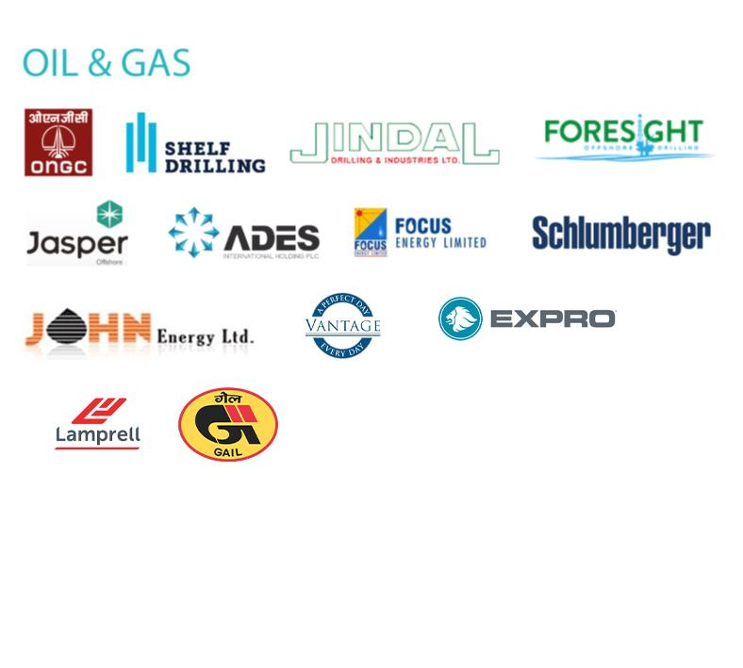
OUR OPERATING DIVISIONS

Slide 10
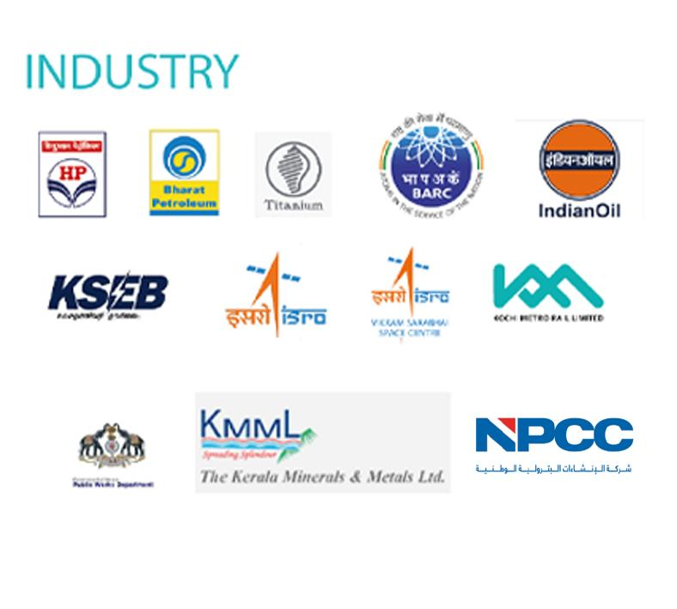
OUR OPERATING DIVISIONS

Slide 11
Our Associates
SCHNEIDER ELECTRIC (Power, PLC, HMI & Controls)
YASKAWA ( VFD Solutions )
AVEVA ( Plant SCADA )
PHOENIX CONTACT ( PLC, HMI & Controls )
DEIF ( Power & Engine Controller )
MSA & SMC ( Fire & Gas Detection systems)
HIK VISION (ATEX Camera Systems)

Slide 12
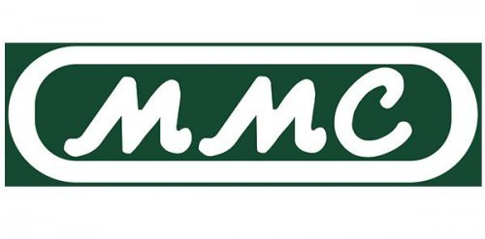
OUR ASSOCIATES
MMC (ullage Interface detection & measurement
HONEYWELL ( Field Devices)
MEIYO Electric ( Precision Sensors )
AQUA METRO ( Flow and Torque Measurement)
Scanjet PSM ( Level Sensors)
Rittal (Enclosures & Busbar Systems )

Slide 13
Electrical & Automation Jobs
We SMEC as a Complete Shipboard Electro (Electrical and Automation) Engineering Design and Development company, presently with local presence in India, UAE, Srilanka and Singapore. We provide global life cycle support for our products at unbeatable costs.
SMEC is today the market leader in the manufacturer of electrical and Control Panels. It caters the leaders in Marine industry. SMEC Produces high quality, performance tested and fully certified control systems. SMEC is the renowned manufacturer of a variety of electrical and control panels in marine industry.
The modular design of our SMEC system combined with effective on-site commissioning tools makes it a logical choice when replacing system. SMEC System also prepares for future upgrades without high investment costs. We have extensive experience replacing various makers of in-house automation systems.

Slide 14
To make sure all refit installations are a success we follow a procedure consisting of four steps:
Site survey:
Our specialist carry out a site survey and prepare a site report. The report includes a suggested system layout, a detailed project milestone plan and a cost analysis. This site report forms the basis for a delivery contract.
Engineering:
The system is carefully tailored to meet customer requirements and is outlined in a design document
Installation:
The system is installed either by our own team of technicians or the customers own staff under supervision of our engineer.
Commissioning and training:
A team of experienced commissioning engineers make sure the system is properly set to work.

Slide 15
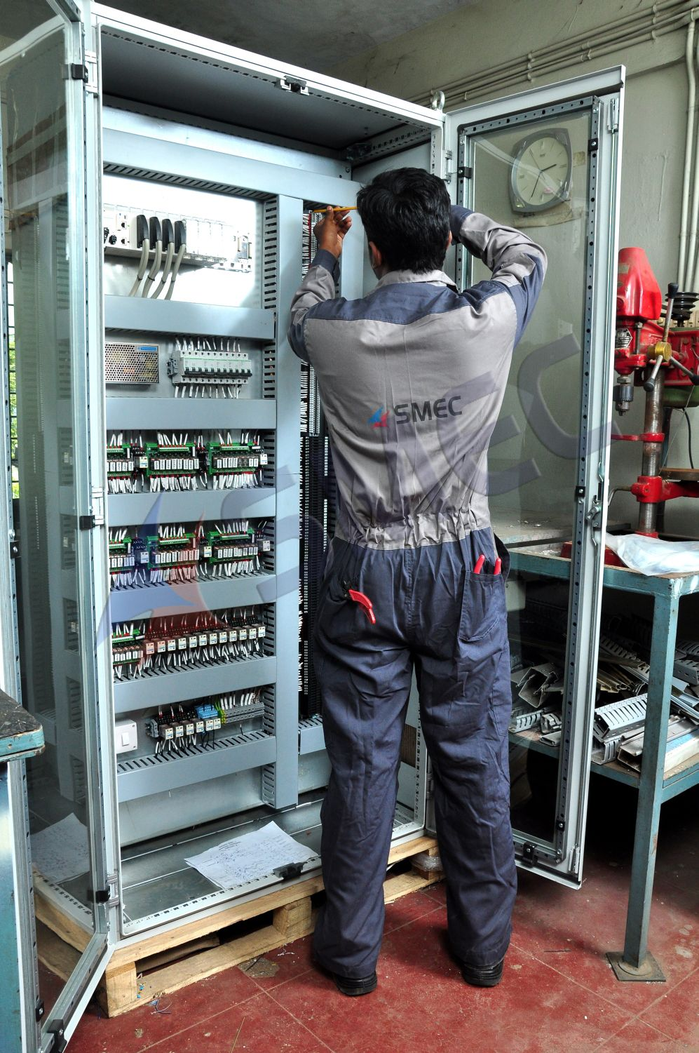
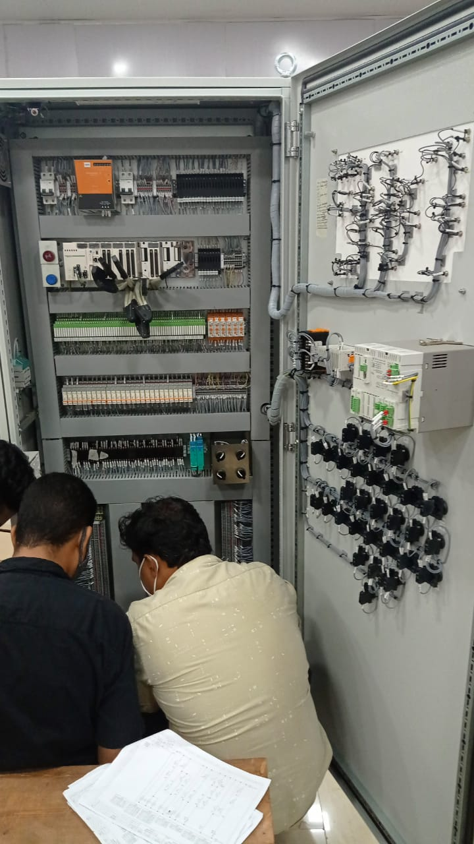
Panel Building in Shop

Slide 16
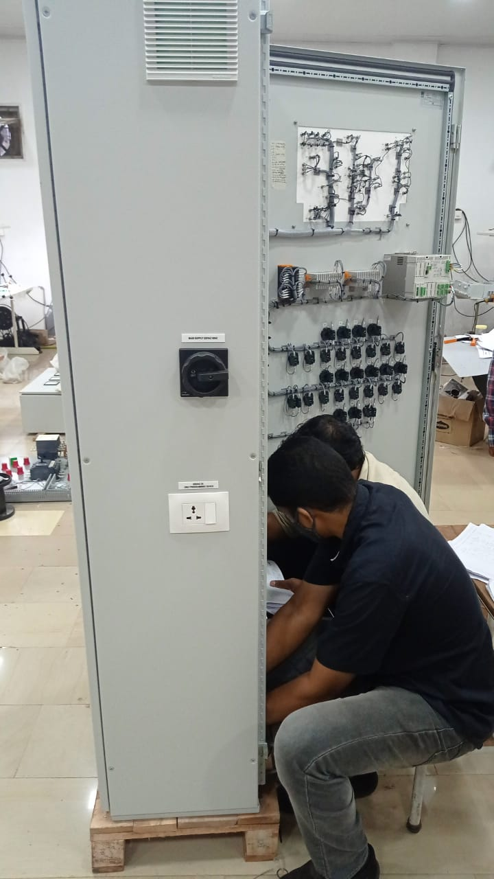
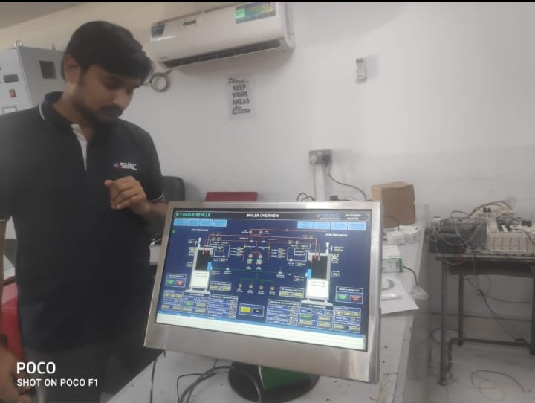
Panel Building in Shop
Boiler Control System designing & Programming

Slide 17
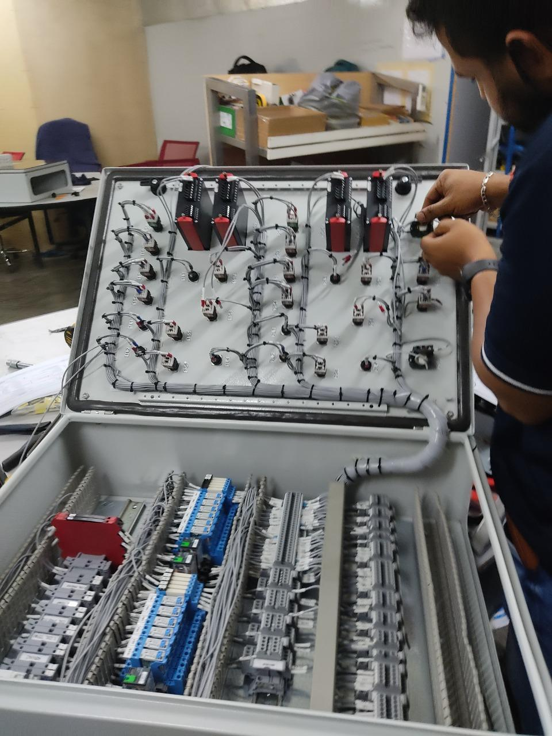
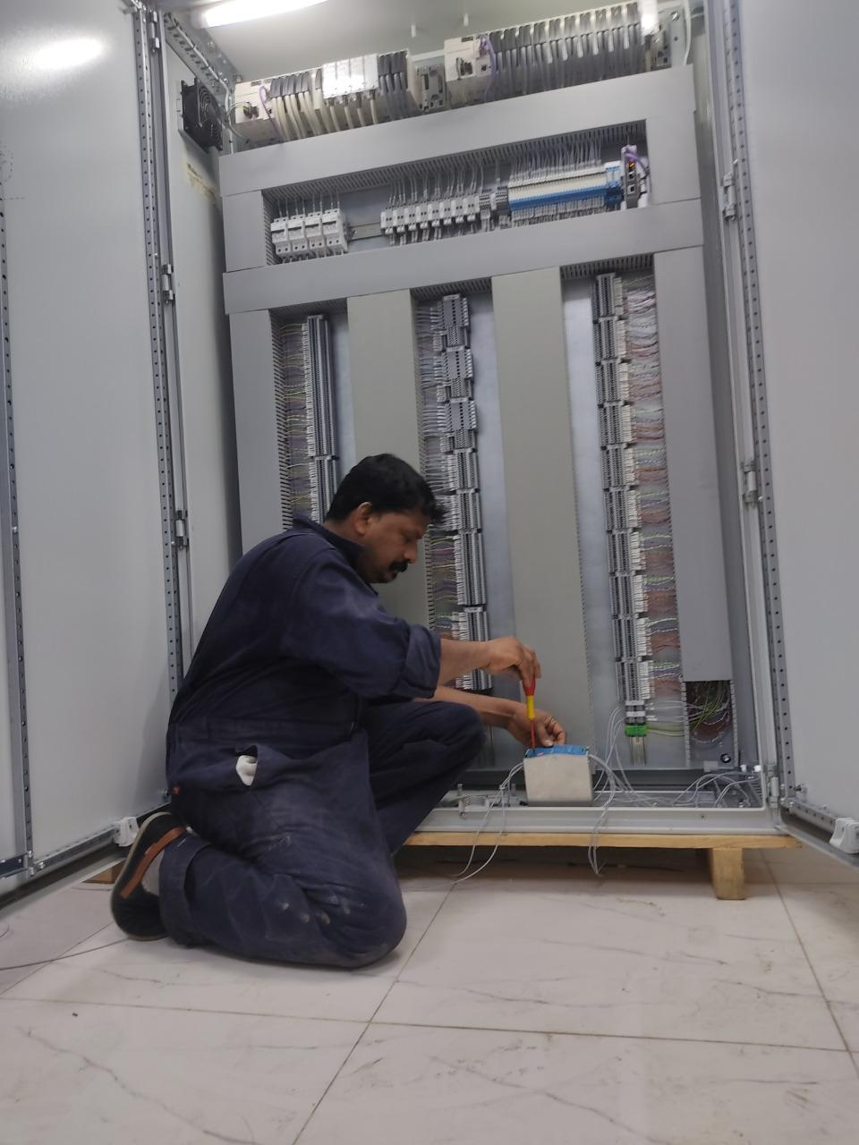
Panel Building in Shop

Slide 18
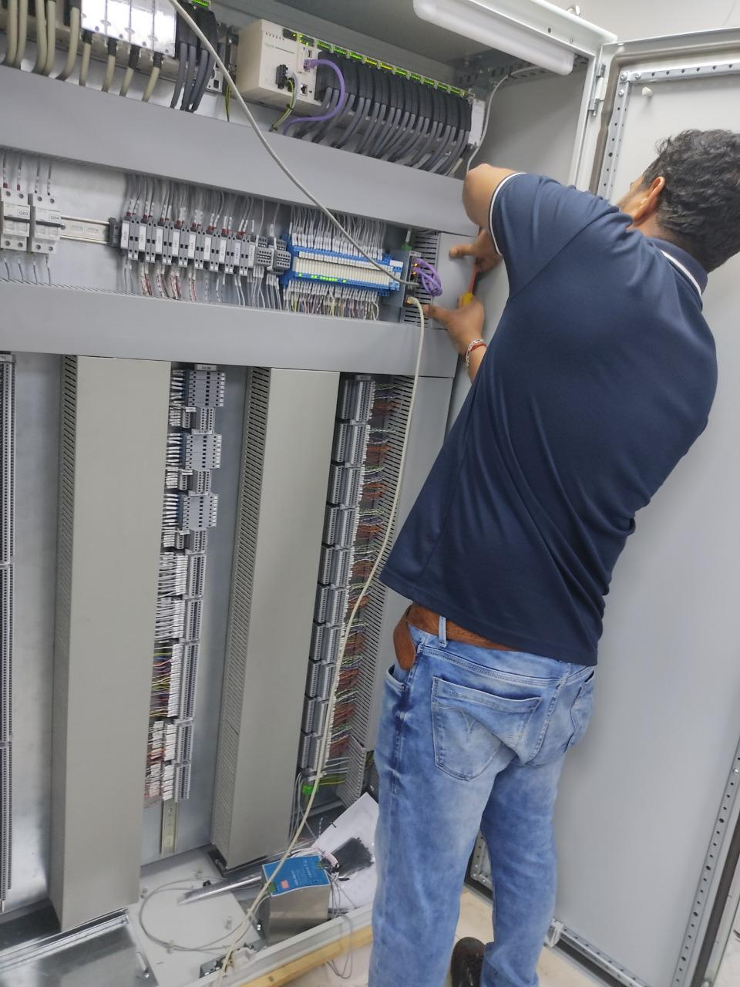
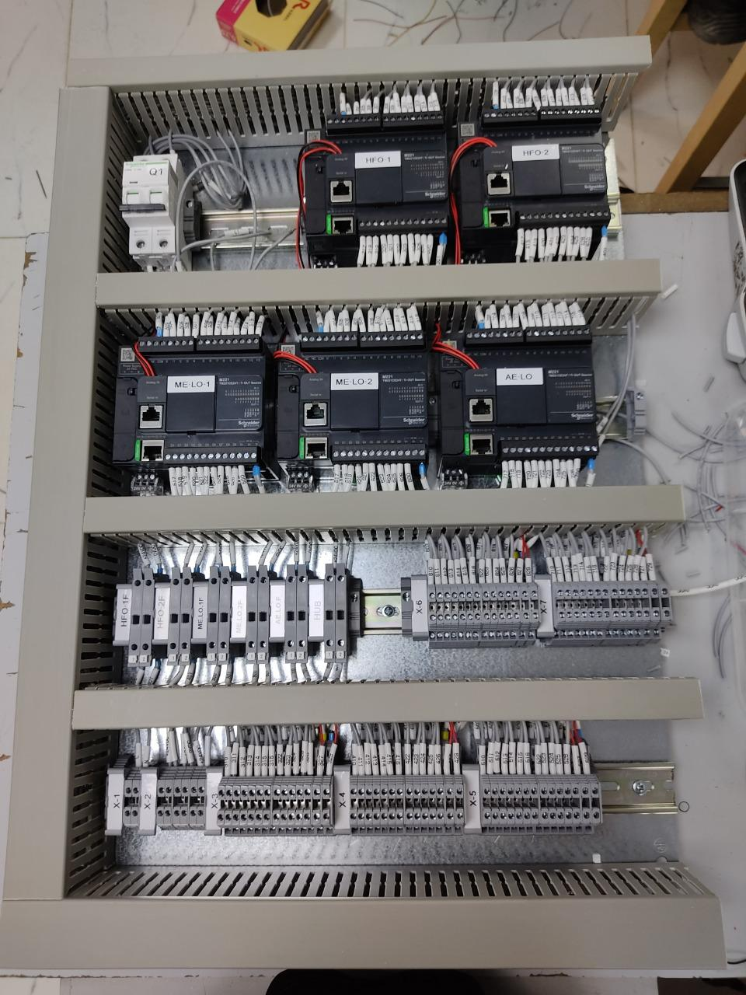
Panel Building in Shop

Slide 19
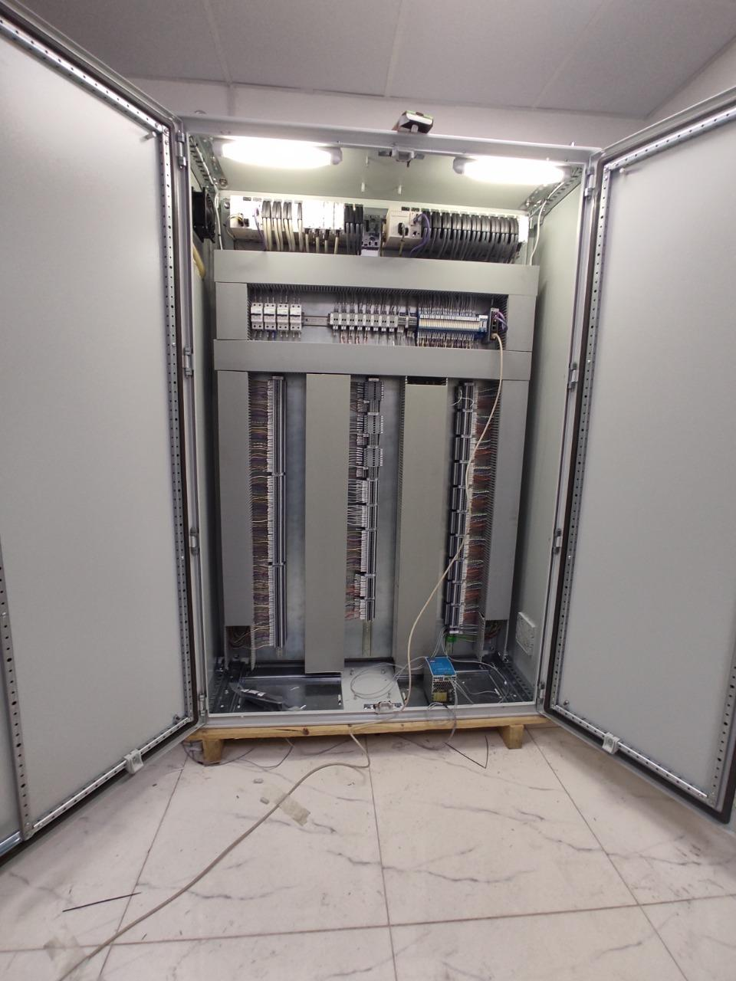
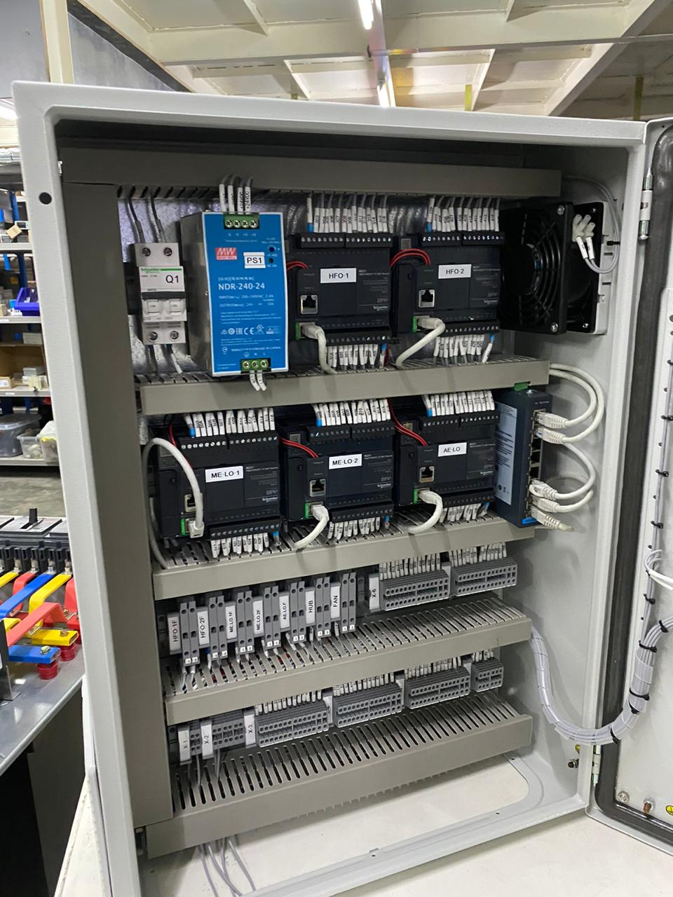
Completed / Ongoing Projects – Electrical & Automation
Purifier Control system

Slide 20
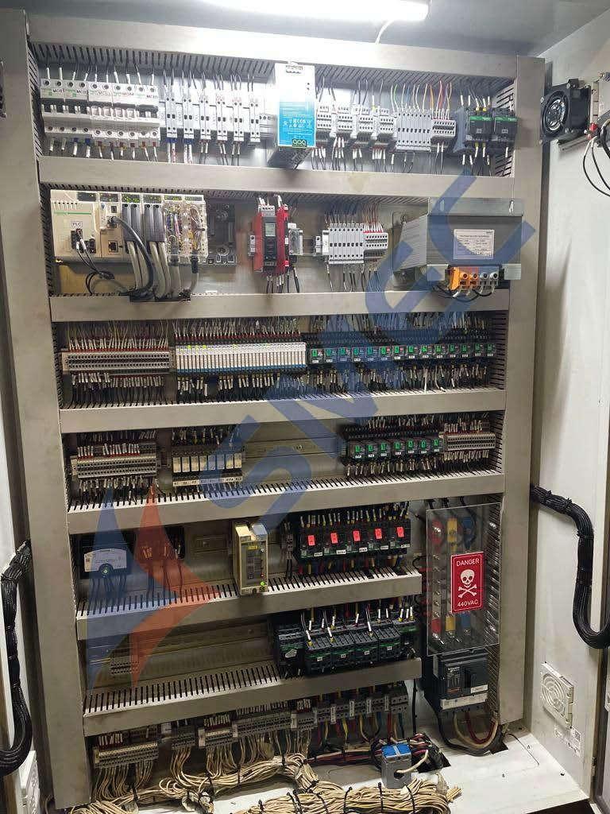
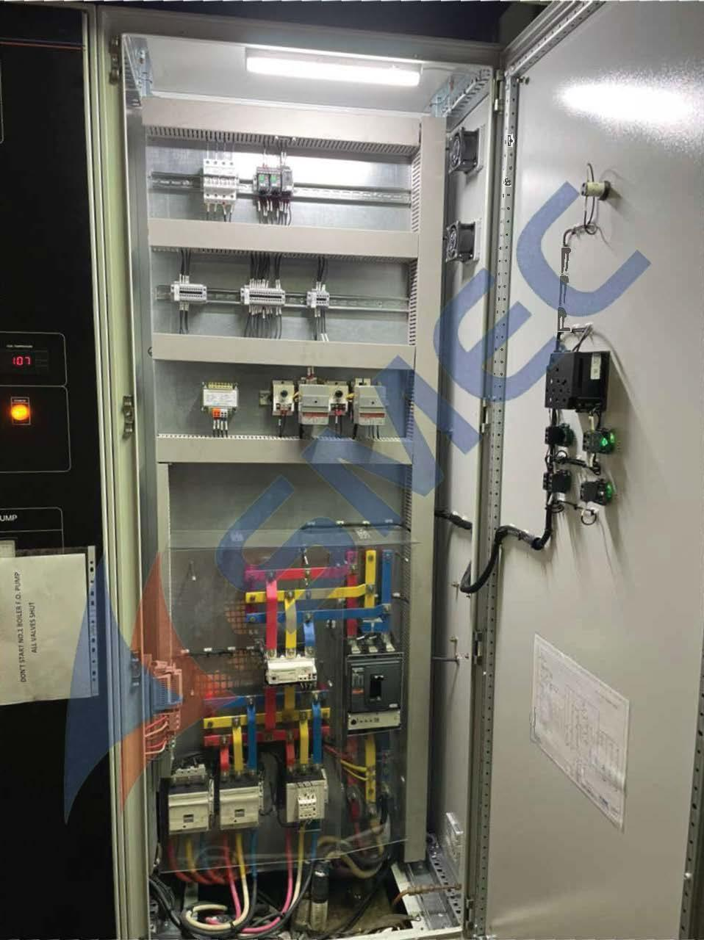
Completed / Ongoing Projects – Electrical & Automation

Slide 21
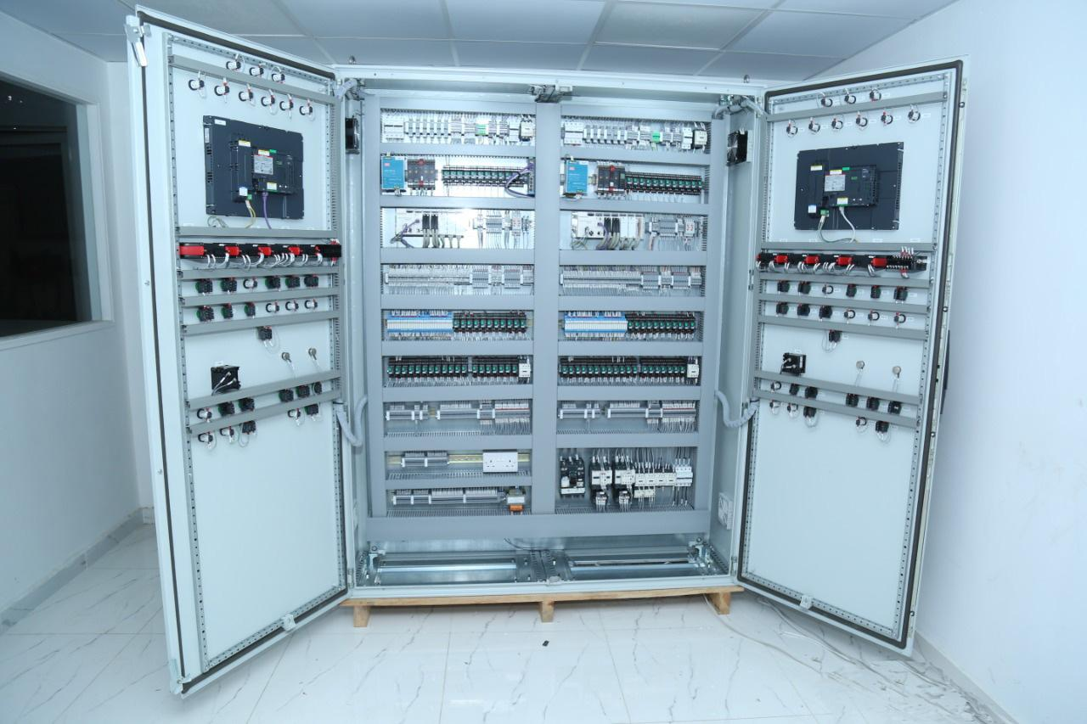
Completed / Ongoing Projects – Electrical & Automation
Boiler Control system

Slide 22
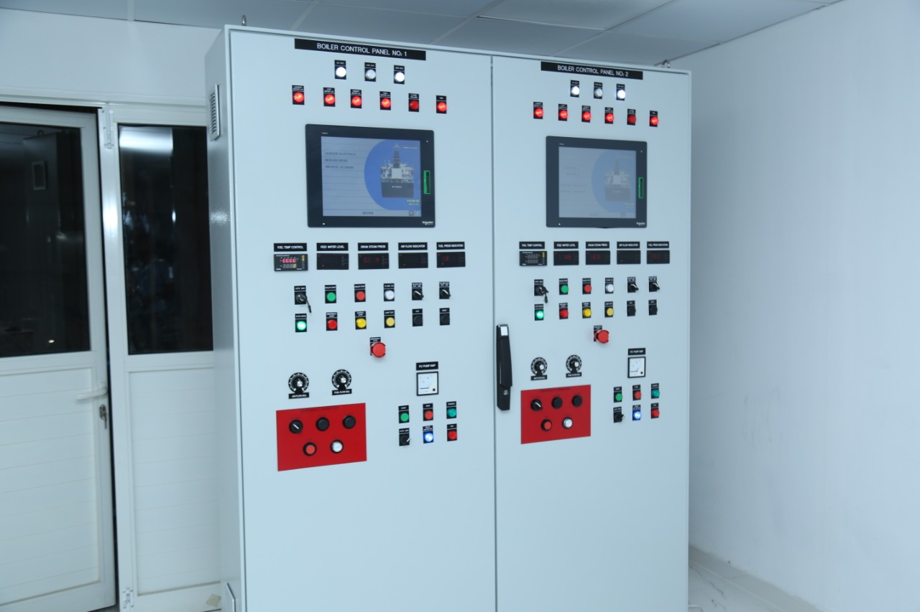
Completed / Ongoing Projects – Electrical & Automation
Boiler Control system

Slide 23
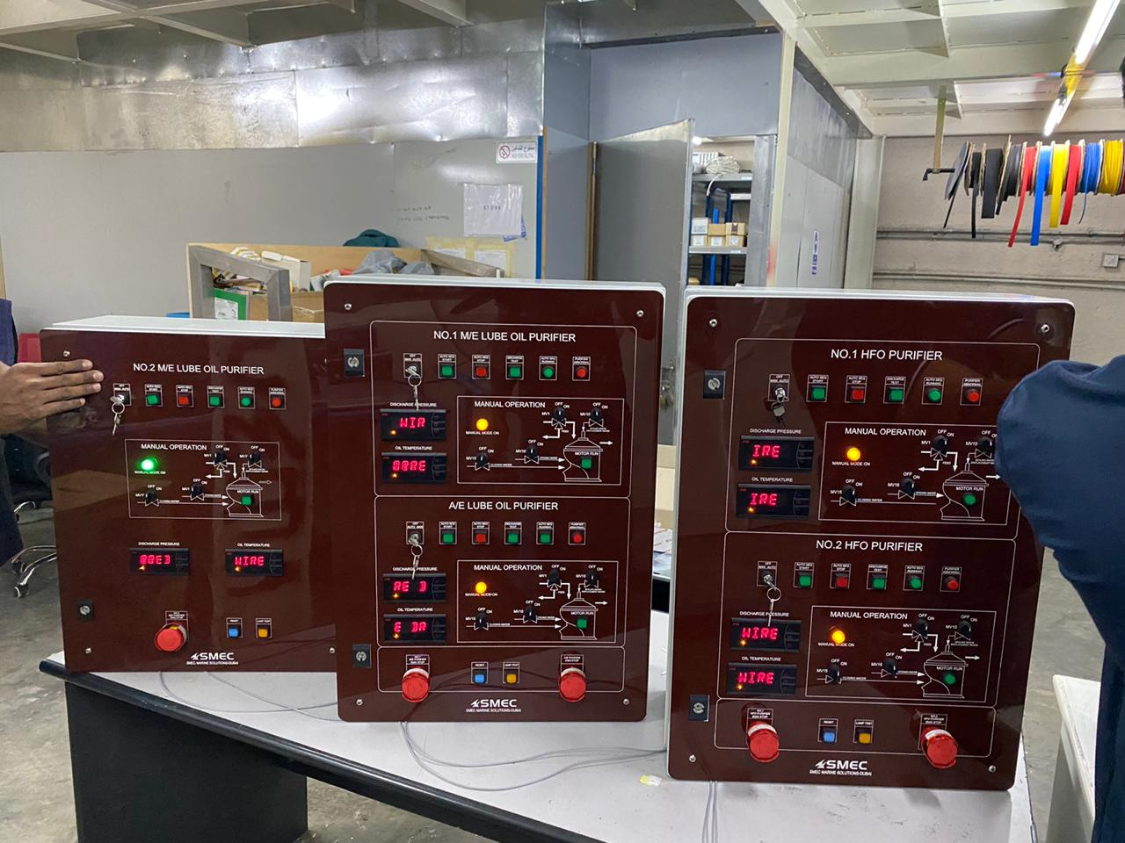
Completed / Ongoing Projects – Electrical & Automation
Purifier Control system

Slide 24
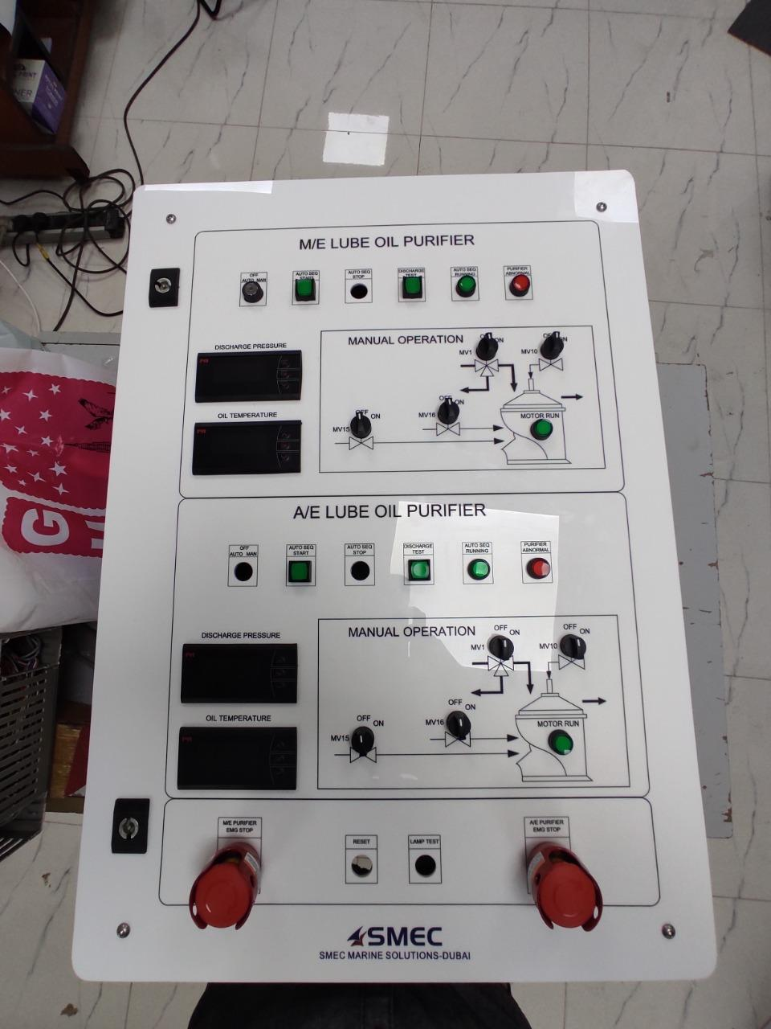
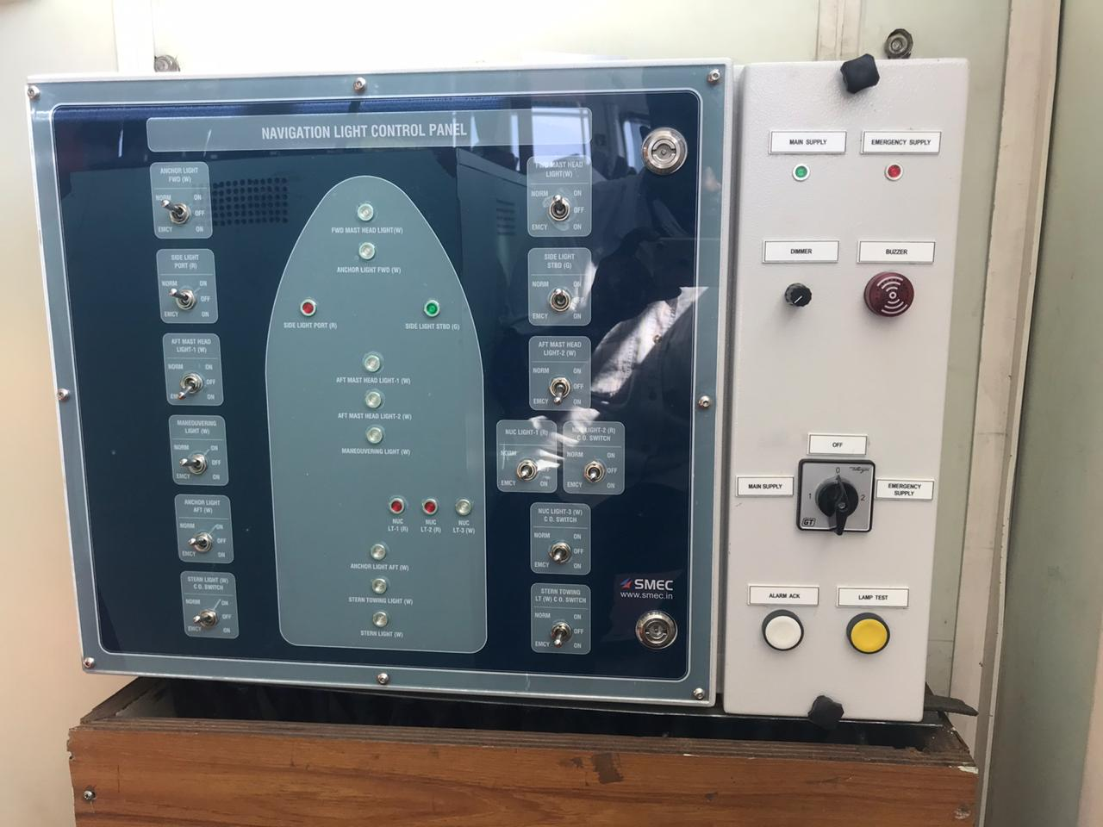
Completed / Ongoing Projects – Electrical & Automation

Slide 25
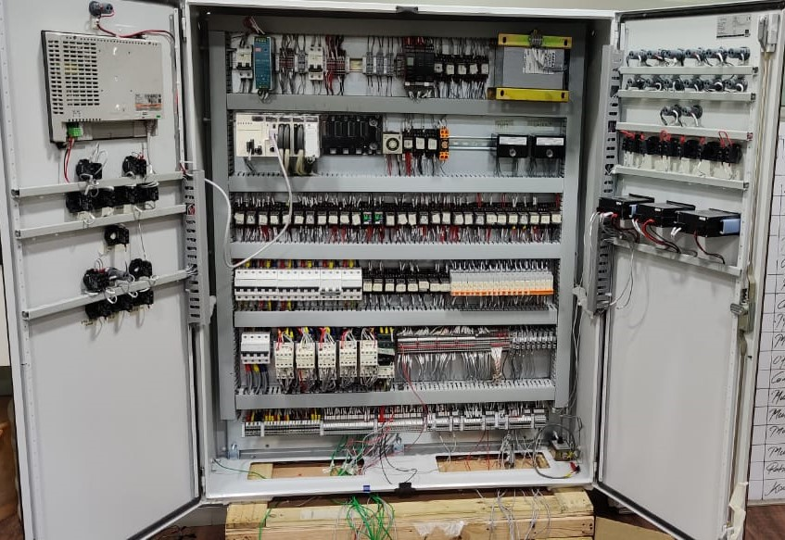
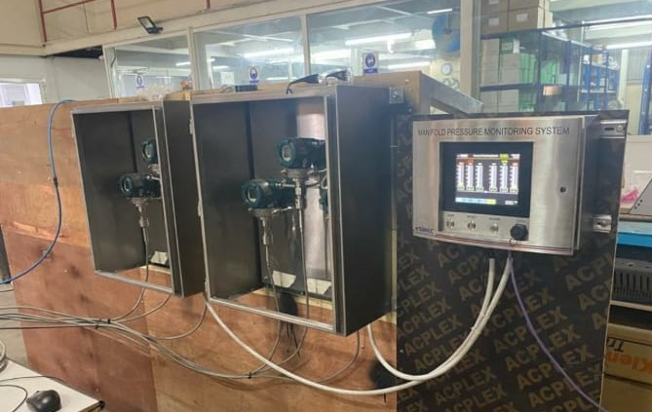
Completed / Ongoing Projects – Electrical & Automation

Slide 26
Completed / Ongoing Projects – Electrical & Automation
SMEC is here to provide all Electrical & Automation solution which complies all your requirements. Which provides services / upgradation of system / New SMEC system as an OEM.
Systems as below
Cargo control console
Integrated Alarm Monitoring system
Starter panels
Power management system
Boiler control system
IG O2 Analyzer
Engine control console
Tank gauging system
Incinerator system
Main Switchboard/Starter panel
Tank level system
Fire alarm system
Emergency Switchboard
Inert gas control system
Tank Overfill alarm system
Engine Data Acquisition system
Battery charging and Discharging Panel
Ballast pump control

Slide 27
Overhauling of M/E Pneumatic system
M/E Alarm control system
Engine order Telegraph
Purifier Control System
Aux. Generators control system
Bow Thruster Control system
Steering gear control system
Hydraulic valve control system
water ingress Alarm system
Feeder panel
Complete Electrical package & Commissioning of BWTS including controls & Integration
Ballast pump control
Generator control panel
Navigation light control panel
Wind monitoring system
pressure monitoring system
Fuel Efficiency / Energy saving and live monitoring system
Fast fuel change over system
Winch system
Window wiper system
Lub oil temp control & Monitoring system
Salinity Monitoring System
Main Engine Governor Control panel
Local control cabinet
Battery charger

Slide 28
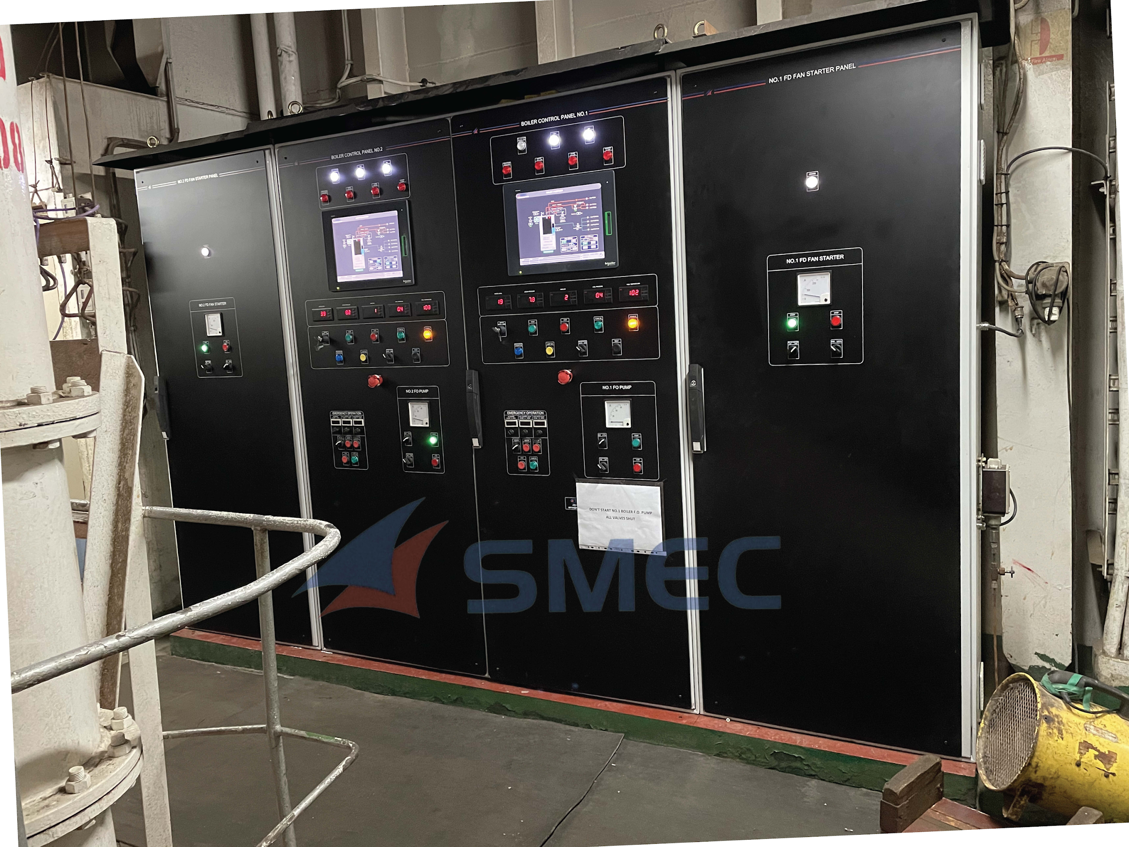
Boiler Control Systems

Slide 29
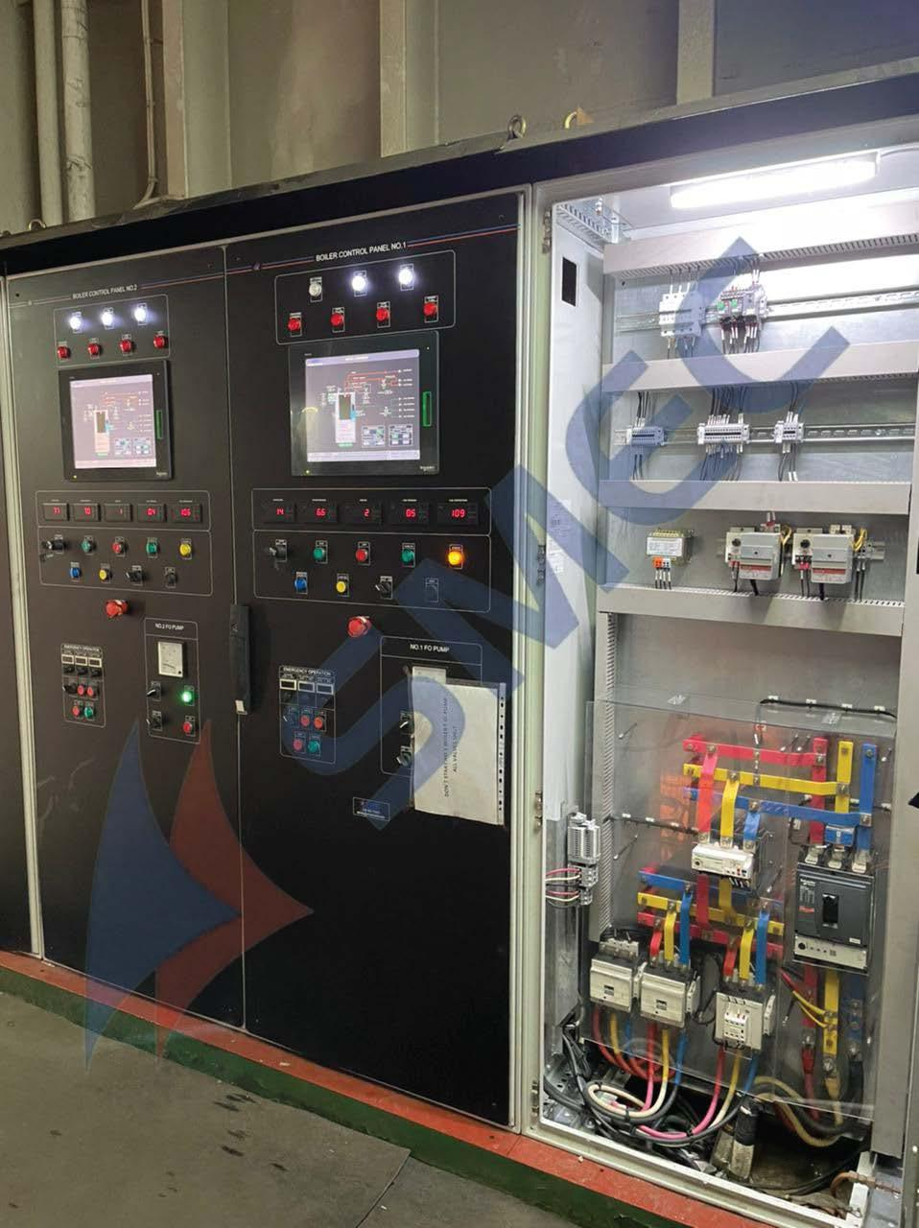
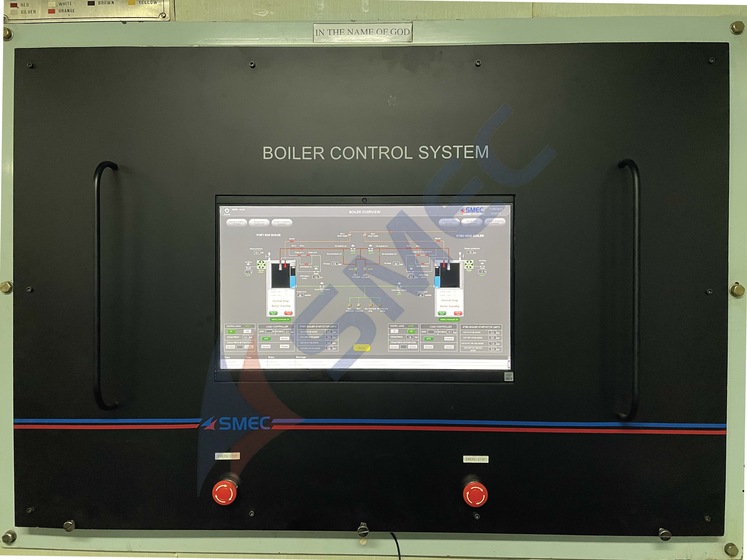
Boiler Control Systems

Slide 30
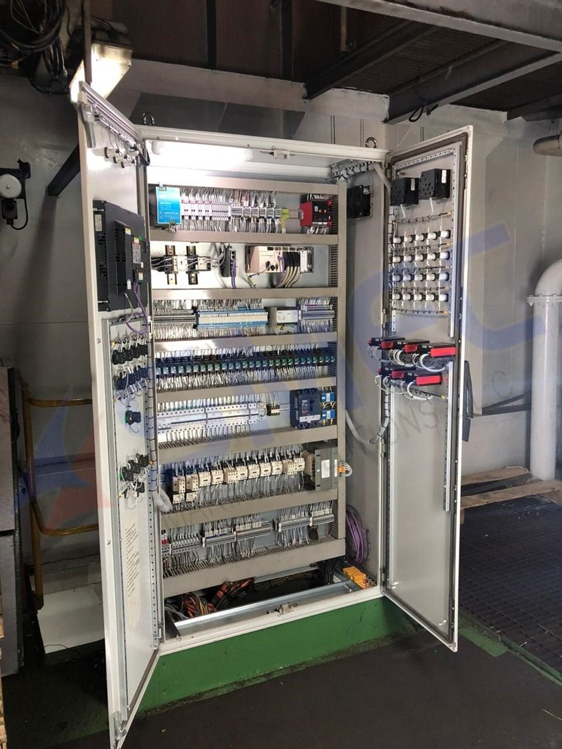
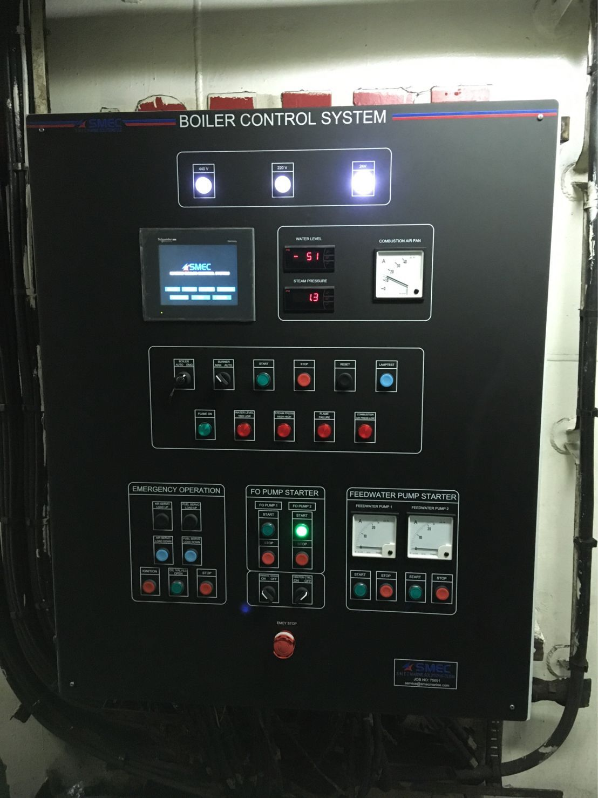
Boiler Control Systems

Slide 31
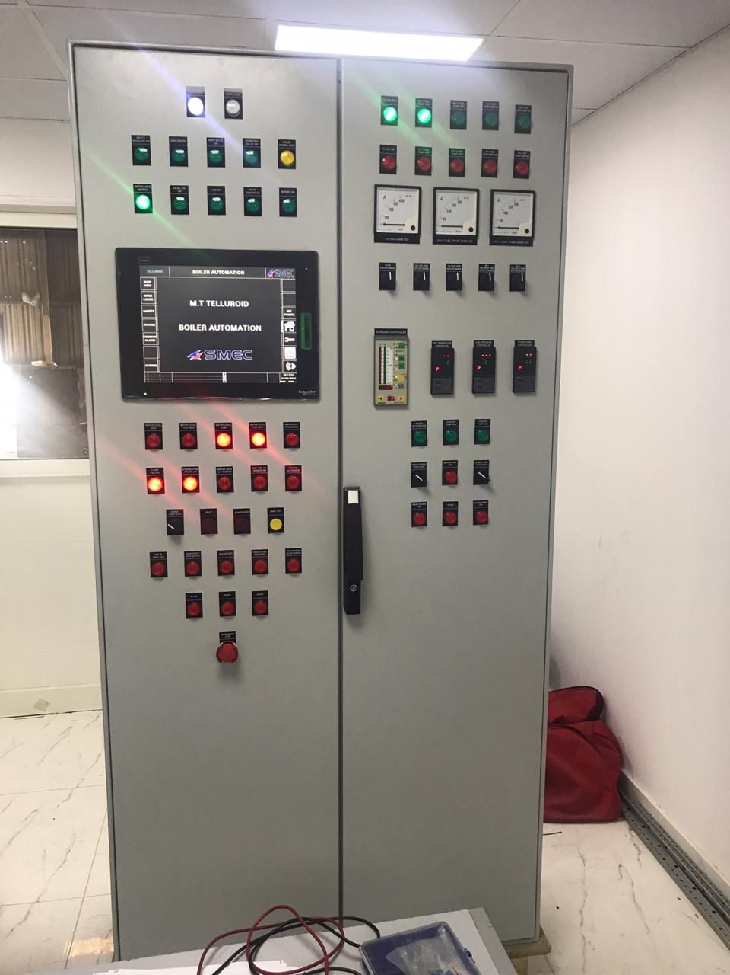
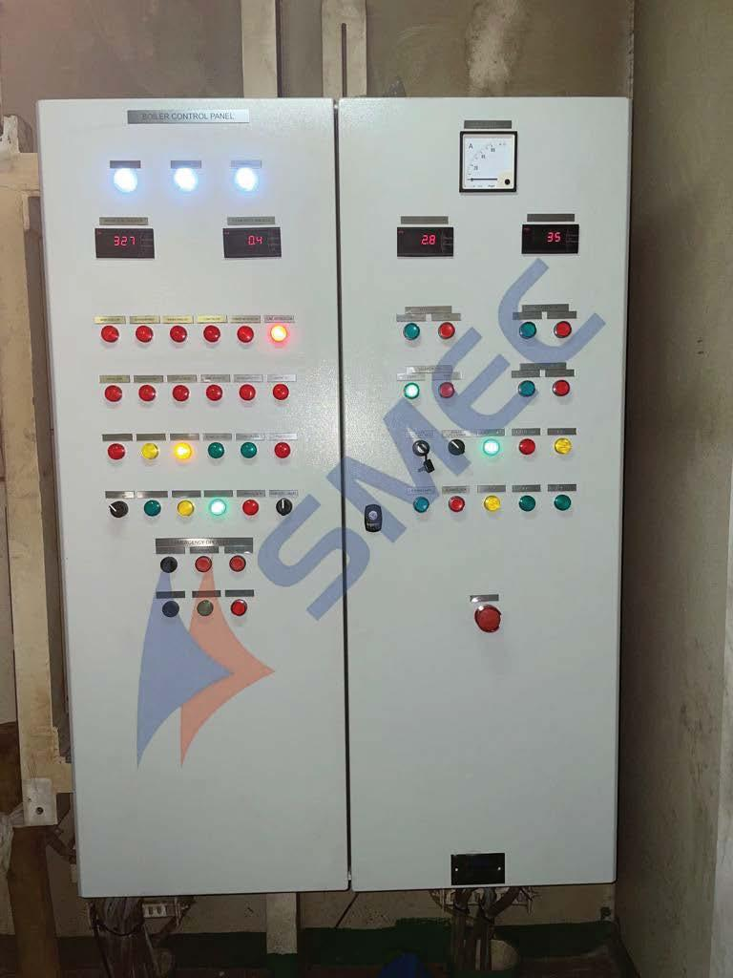
Boiler Control Systems

Slide 32
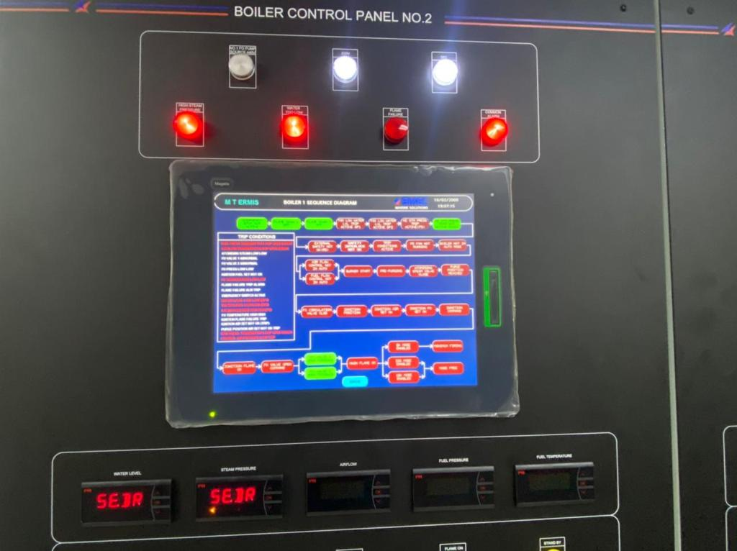
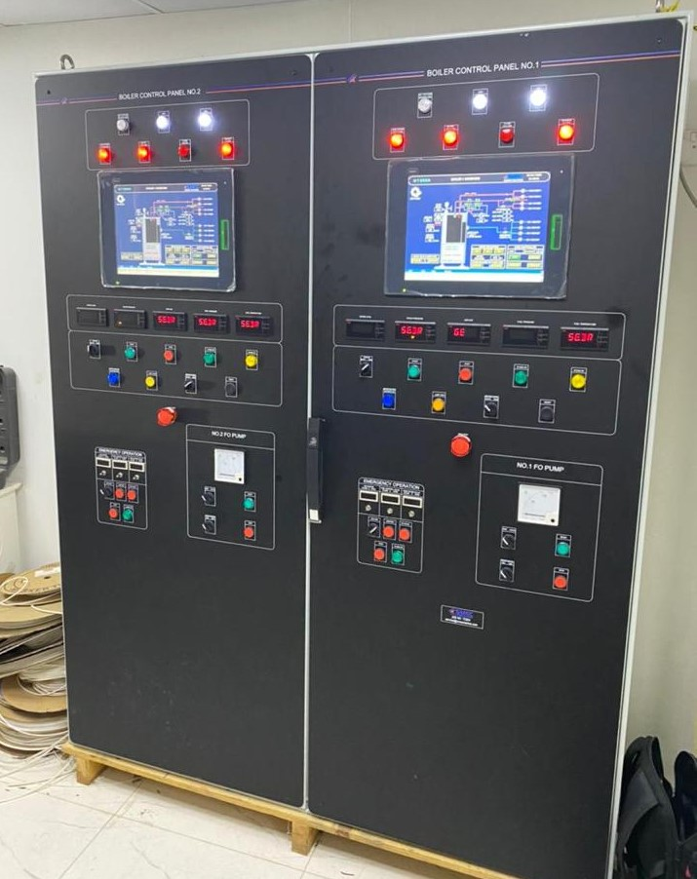
Boiler Control Systems

Slide 33
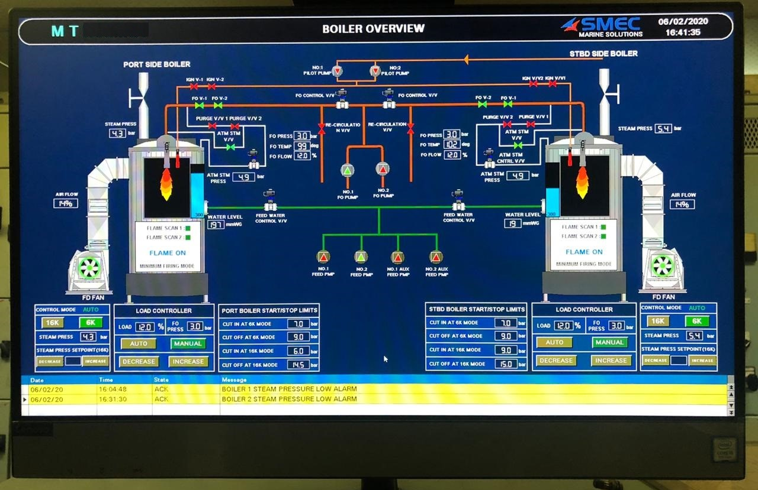
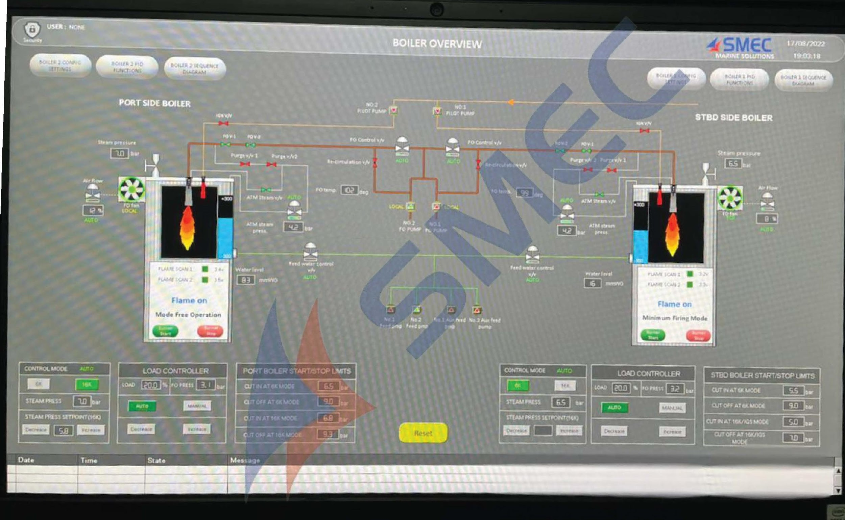
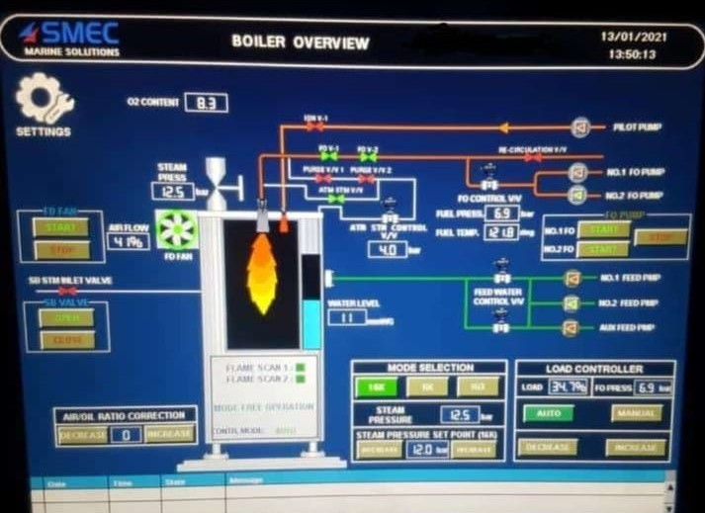
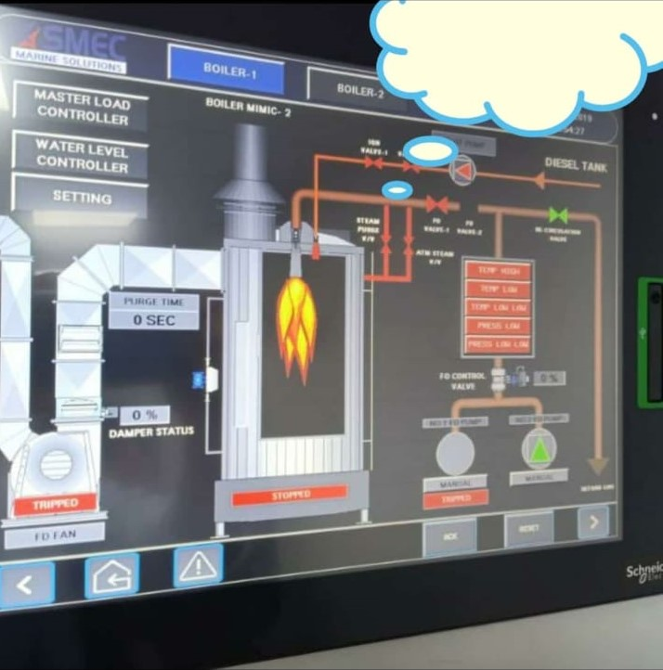
Boiler Control Systems

Slide 34
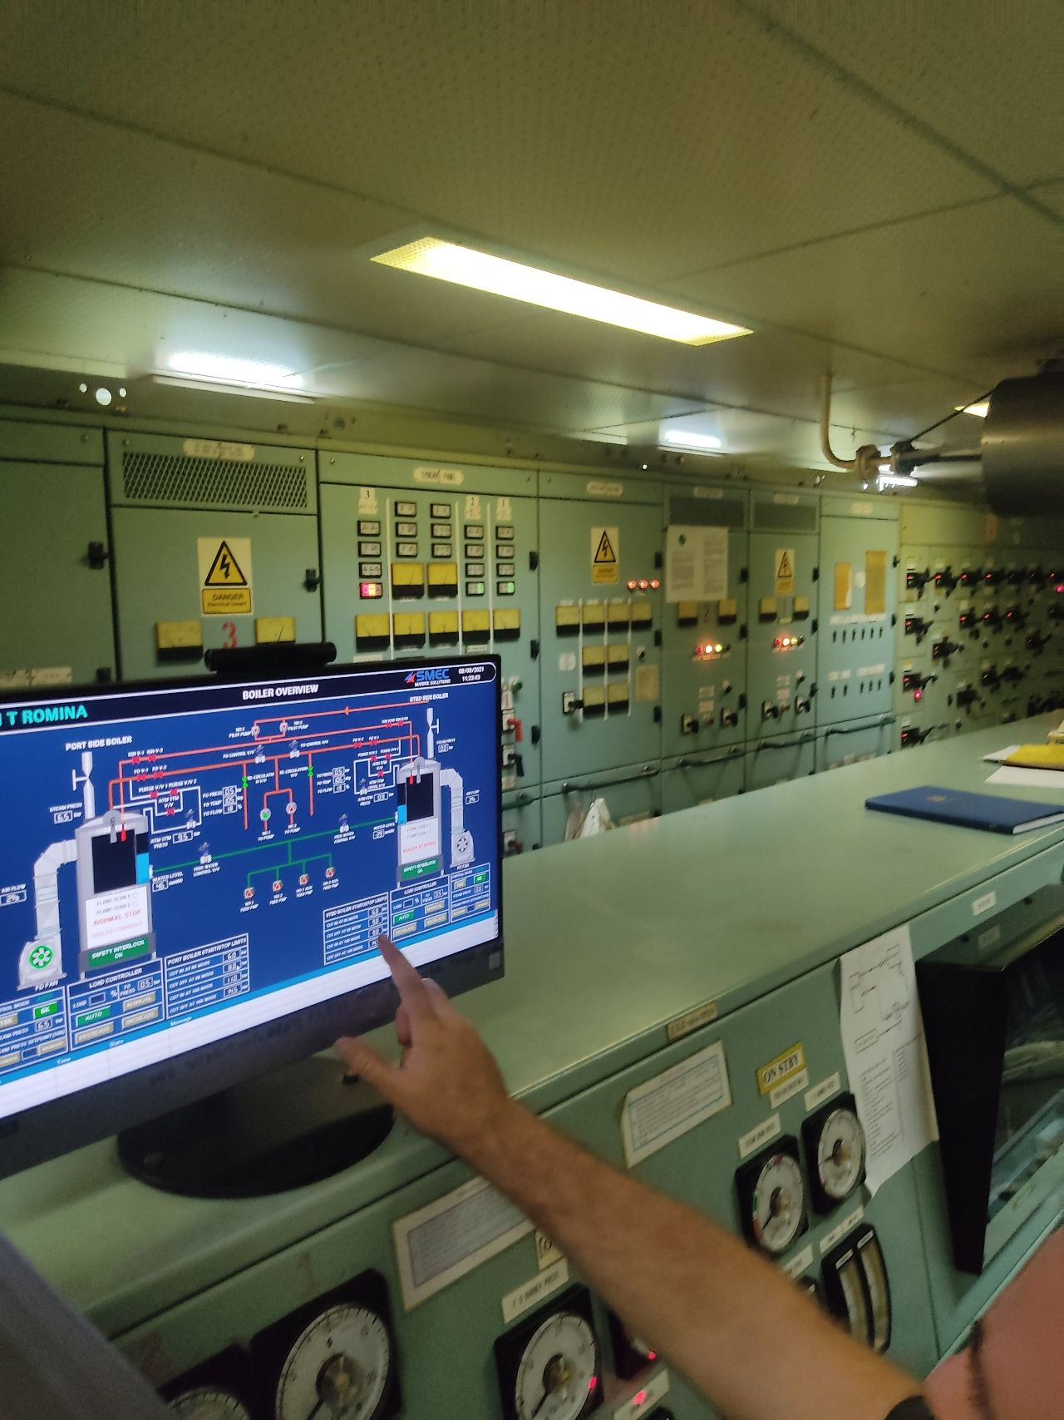
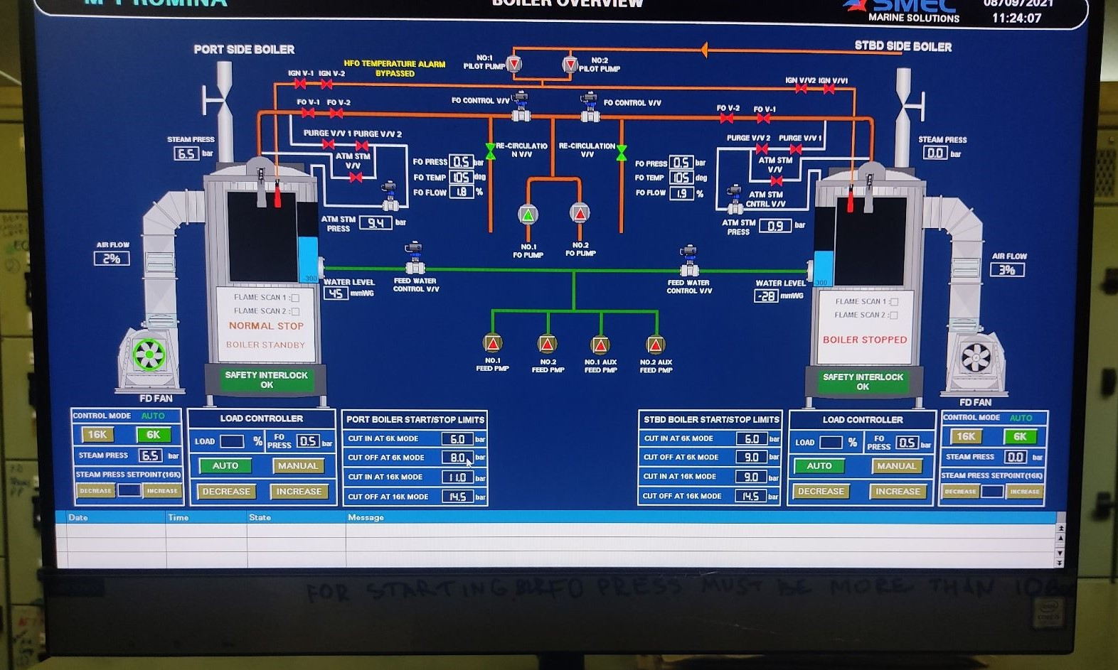
Boiler Control Systems
SMEC MARINE SOLUTION offers a smooth and simple way to replace your existing Aalborg and Mitsubishi boiler control system with the highest standard in SMEC Boiler control system.

Slide 35
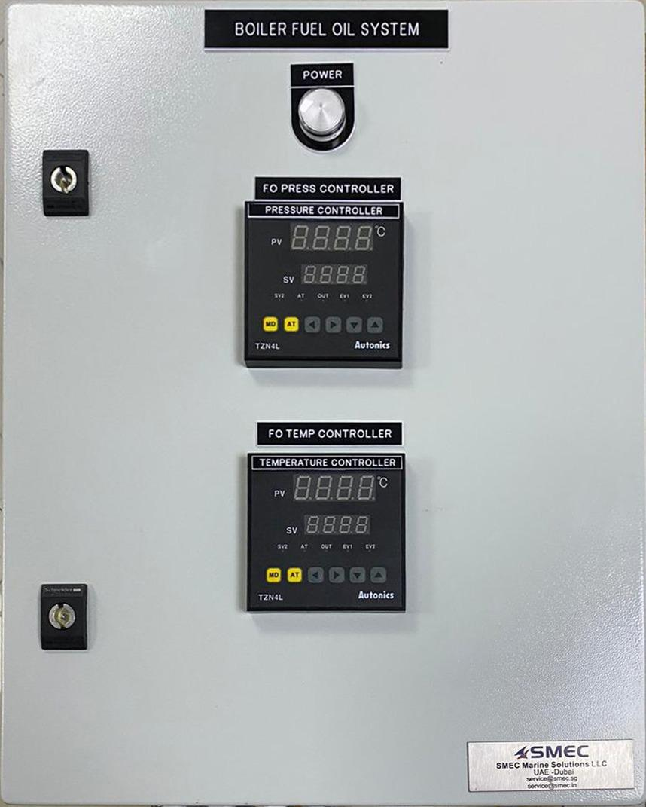
Boiler Fuel Oil System

Slide 36
Boiler Control Systems
Benefits
Quick and easy exchange of Control System
Delivery time of 6-7 days
Simplified boiler operation with improved over view for both panels on one screen
Online fuel monitoring system integrated
Advance shore trouble shooting and 10 scanning features
Mobile application for boiler status
Easier connection to ship control and communications systems (coverage for all major bus interface)
Upgradable software for easy integration of new features
Future-proof expansion options
Last year SMEC replaced many Mission OL
(Unisab), KBSD and Mitsubishi type,
MAC-20B, MAC -25B, MAC -30B, MAC -35B, MAC-
40B, MAC -45B, MAC -SOB, MAC -55B

Slide 37
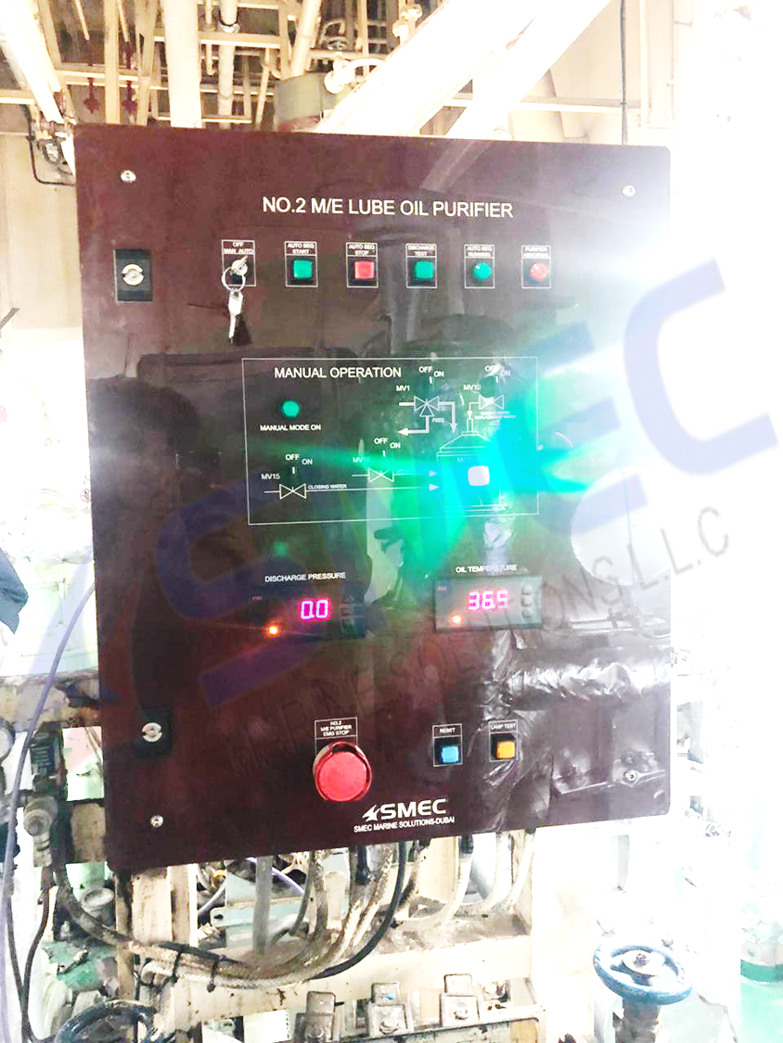
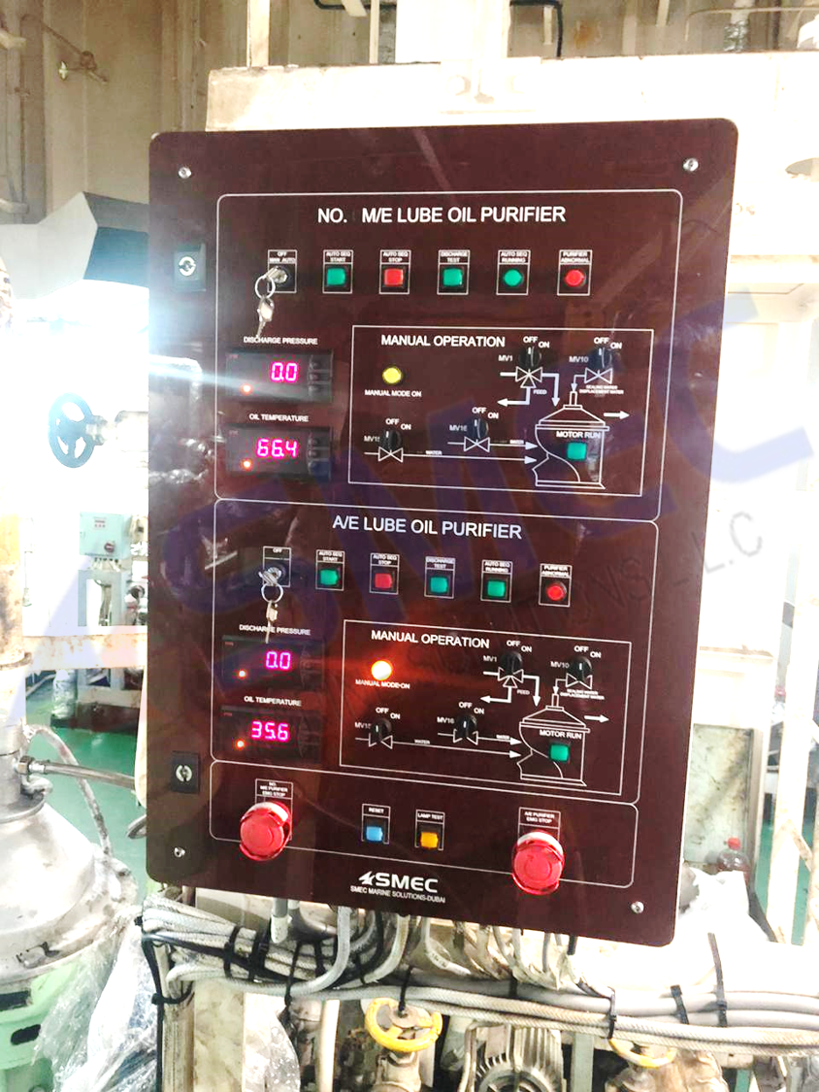
Purifier Control System

Slide 38
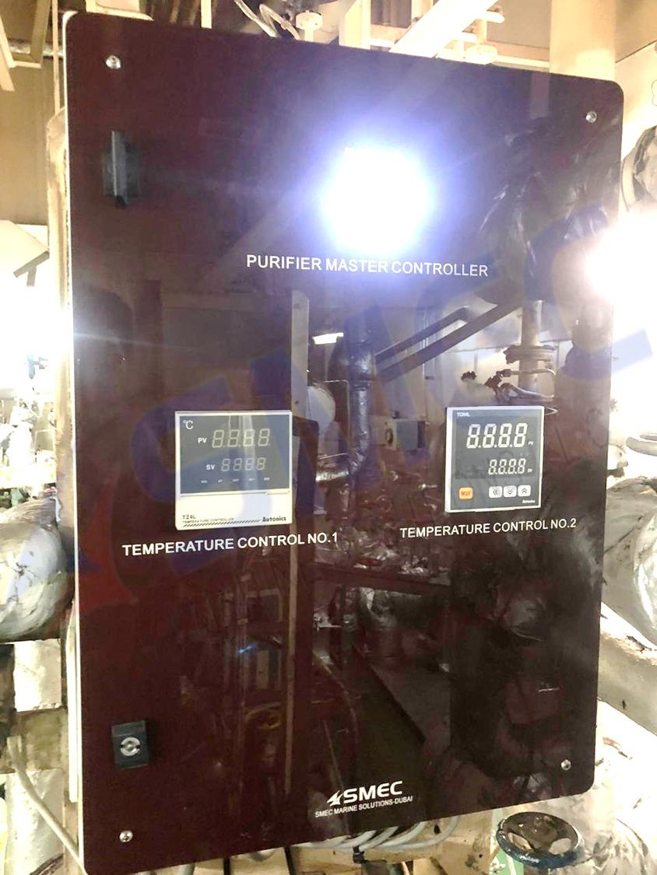
Purifier Control System

Slide 39
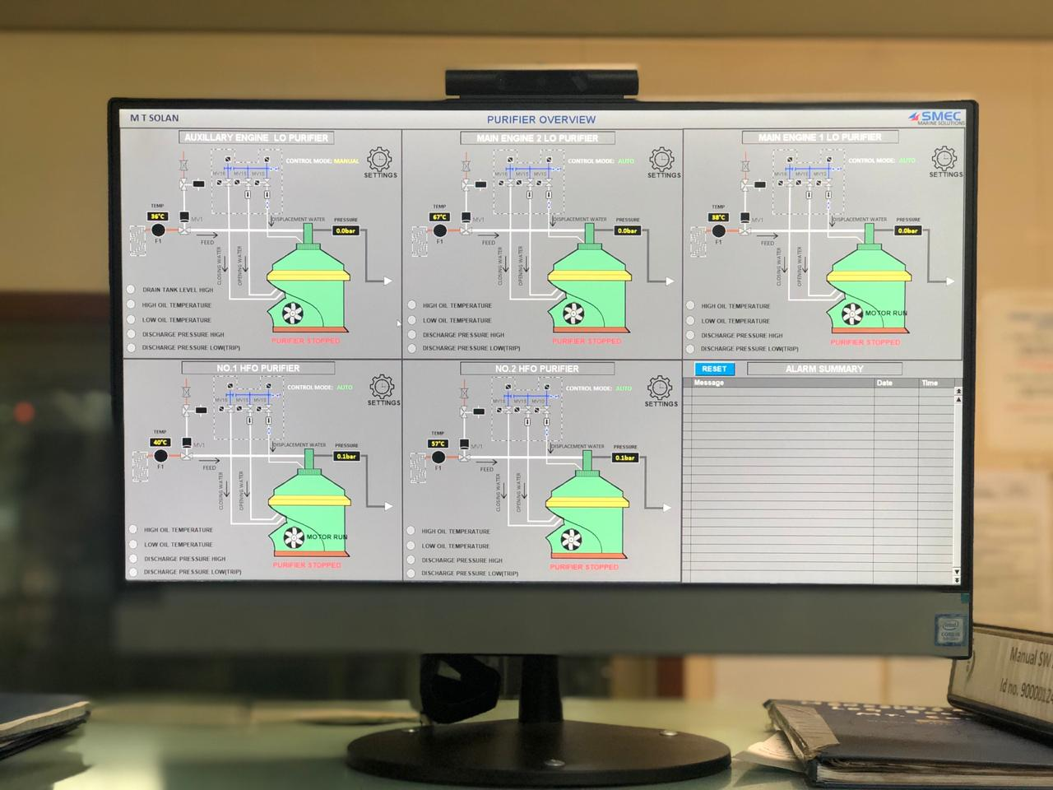
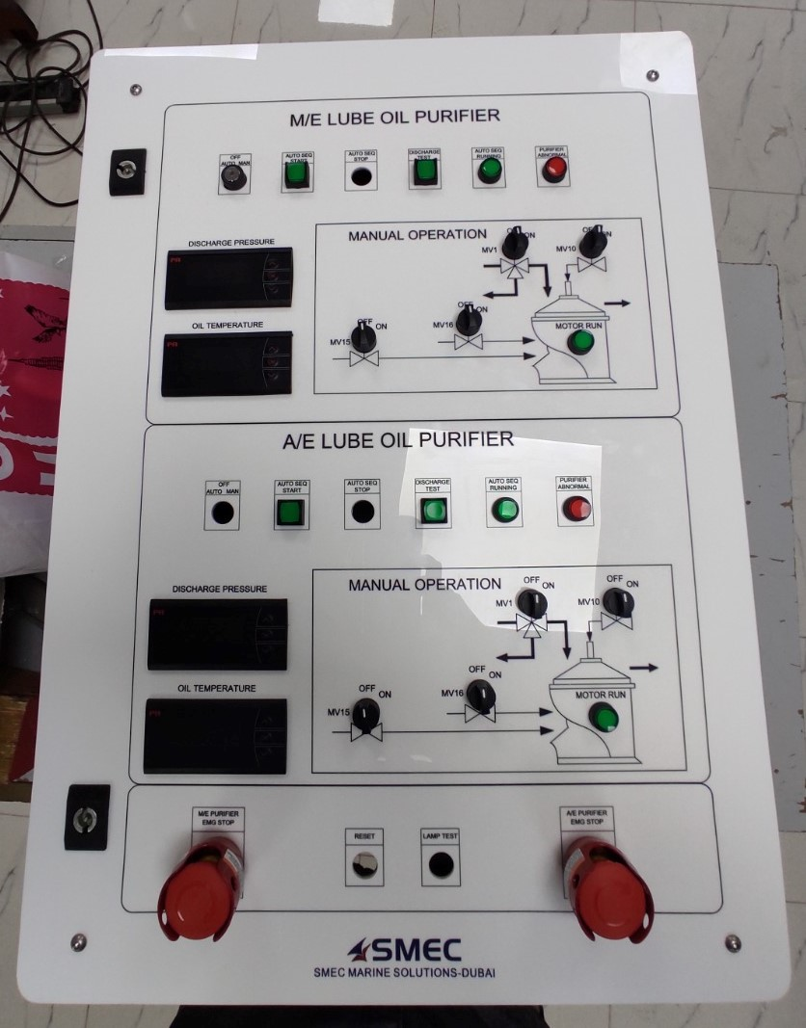
Purifier Control System

Slide 40
Purifier Control Systems
Our PLC based Purifier control system for a commercial ship complies with commercial class requirements, commonly referred to as DAU modules, are used to gather & process incoming signals from various sensors and to communicate with the PLC. SMEC offers a range of services that can be tailored to your needs and the age and operating pattern of your vessel. They include replacements for all centrifugal separators used in the marine industry. SMEC purifier Master Control Panel installed outside purifier room for protect the temperature-moisture and remote monitor can able to adjust the time settings.

Slide 41
Benefits
Safe auto operation.
Reduced power consumption, wear and oil losses.
Service alert features.
Continues monitoring remote monitor.
Master control unit located outside purifier room to protect temperature.
Easier operation and improved automation.
Quick and easy exchange of Control System.
Delivery time of 6-7 days.
Simplified boiler operation with improved over view all purifier on one screen.
Advance shore trouble shooting and IO scanning features.
Easier connection to ship control and communications systems.
Upgradable software for easy integration of new features.
Future-proof expansion options.
Manual operation features.
Local indication for pressure and temperature.
Discharge test.

Slide 42
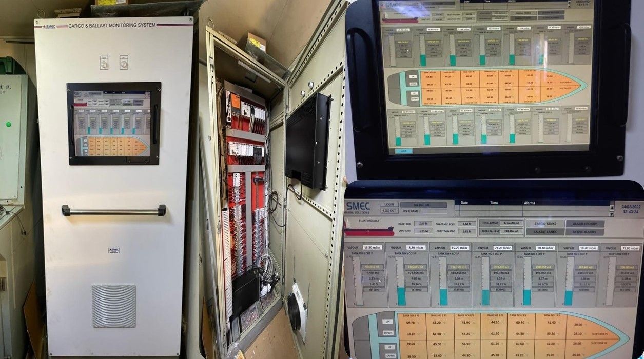
Cargo & Ballast Monitoring System

Slide 43
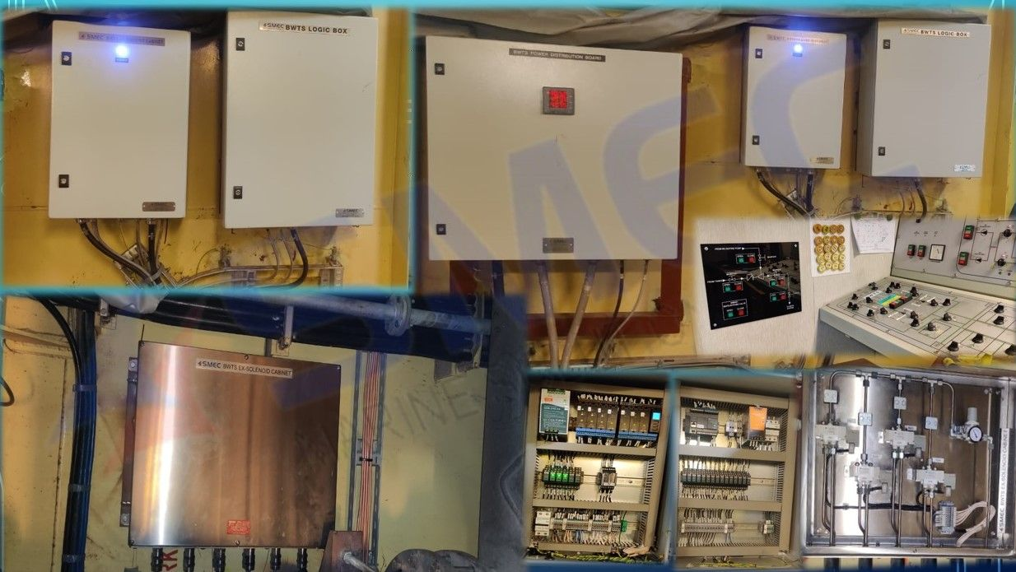
BWTS Project Installation at Turkey

Slide 44
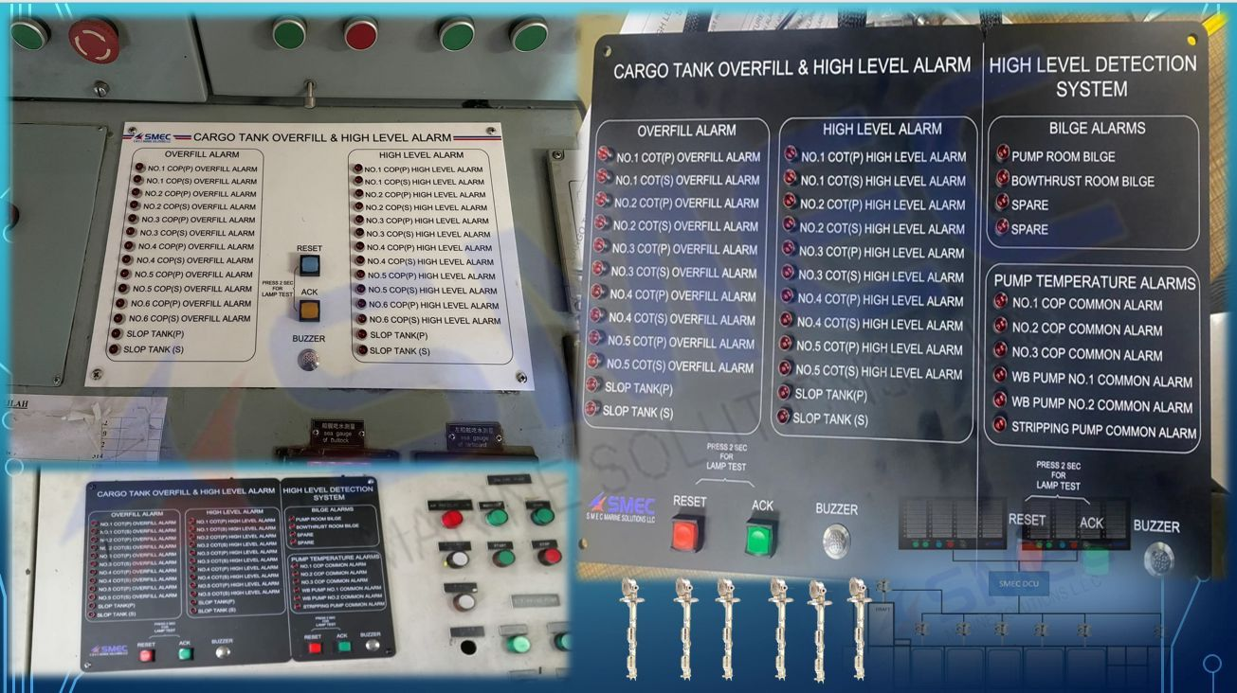
Cargo Tank Overfill Alarm System

Slide 45
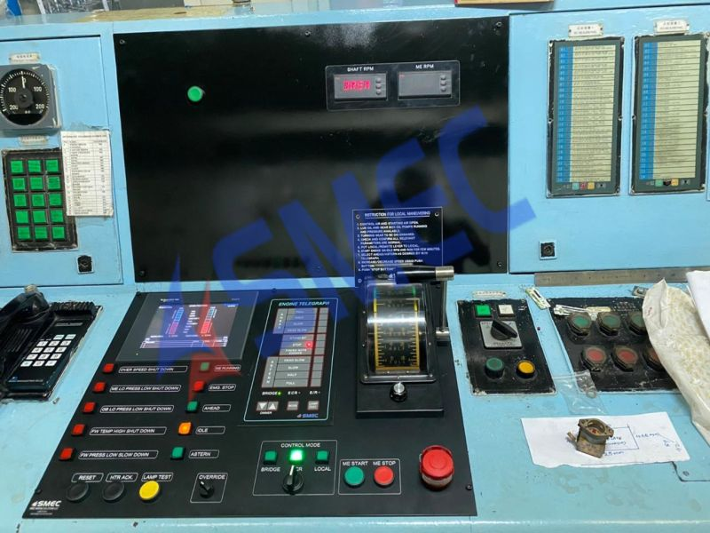
M/E manoeuvring system with Telegraph

Slide 46
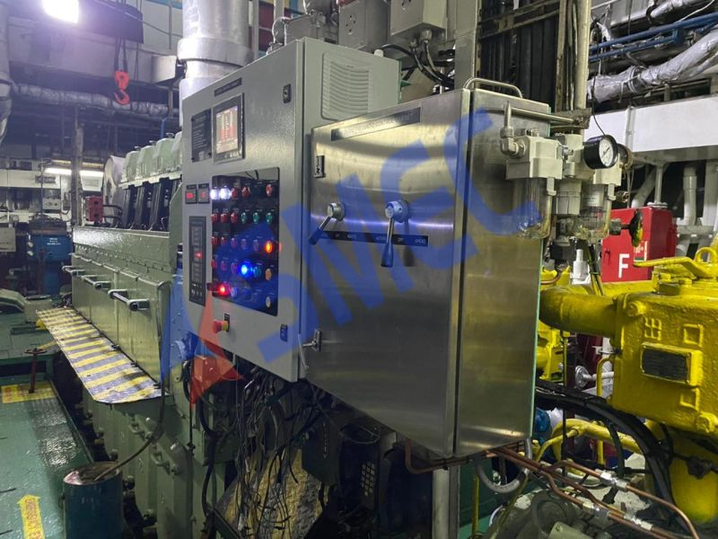
Retrofitting M/E manoeuvring system with Telegraph
We are pleased to inform you that AVENTICS (Formerly REXROTH PNEUMATICS), has retained SMEC as its authorized sales and service provider for their Marine PNEUMATIC and Control products.
We have our core team at Dubai who can do the overhauling of M/E pneumatic system in 35-40 hrs with repair kits.

Slide 47
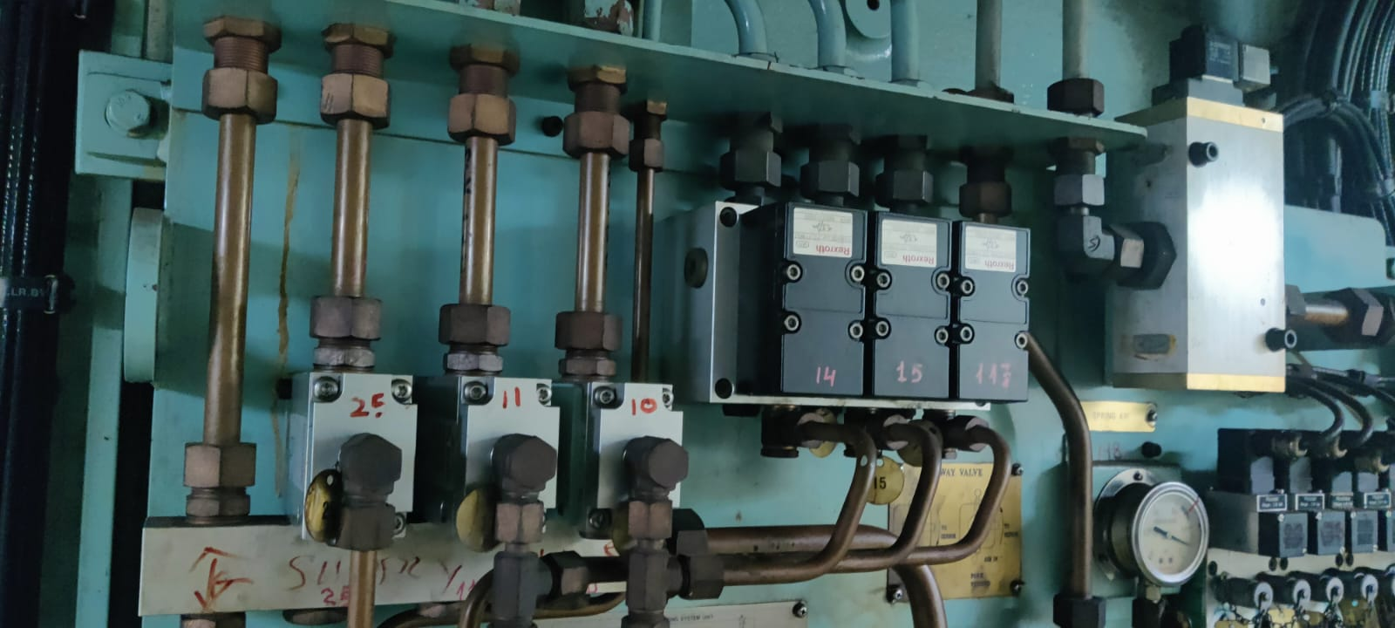
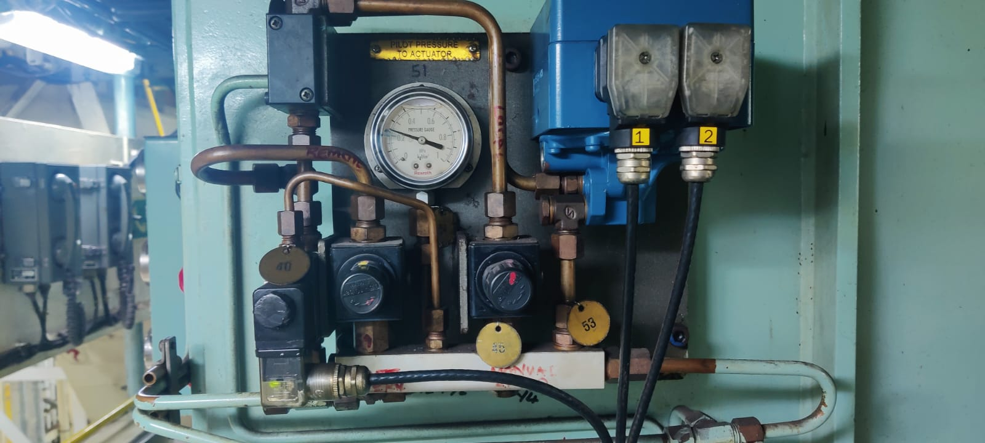
Overhauling of M/E manoeuvering system with repair kit
We are pleased to inform you that AVENTICS (Formerly REXROTH PNEUMATICS), has retained SMEC as its authorized sales and service provider for their Marine PNEUMATIC and Control products.
We have our core team at Dubai who can do the overhauling of M/E pneumatic system in 35-40 hrs with repair kits.

Slide 48
Overhauling of M/E manoeuvering system with repair kit
We are pleased to inform you that AVENTICS (Formerly REXROTH PNEUMATICS), has retained SMEC as its authorized sales and service provider for their Marine PNEUMATIC and Control products.
We have our core team at Dubai who can do the overhauling of M/E pneumatic system in 35-40 hrs with repair kits.

Slide 49
Overhauling of M/E manoeuvering system with repair kit
We are pleased to inform you that AVENTICS (Formerly REXROTH PNEUMATICS), has retained SMEC as its authorized sales and service provider for their Marine PNEUMATIC and Control products.
We have our core team at Dubai who can do the overhauling of M/E pneumatic system in 35-40 hrs with repair kits.

Slide 50
Aux Engine Alarms

Slide 51
SMEC Fast Fuel Change Over System

Slide 52
IG O2 ANALYZER

Slide 53
Inert Gas System Control Panel

Slide 54
SMEC S-Gauge Monitoring system

Slide 55
SMEC Wind Monitoring System

Slide 56
Our Products
Drill Monitor
Watch Free System
Barge Instrumentation System
SCR System / SCR House
VFD System / VFD House
E House
TDS House
Power Management System
MCC & Starter Panels
DCS / SCADA Systems
Engine Safety System
Gas Monitoring System
CCTV System
Flare Boom Ignition System
Jacking Control System
Fingerboard Control System
Running Line Tension Monitoring System
Bulk Weight Monitoring System
Anchor Winch Controls
Crane controls
Hydraulic Power Pack
Switch Boards

Slide 57
OUR FACILITY
OUR
Associates
Dubai office
“Customer service shouldn’t just be a department, it should be the entire company”
“The goal as a company is to have customer service that is not just the best but legendary”

Slide 58
OUR FACILITY
Dubai office

Slide 59
OUR FACILITY
MUMBAI, TALOJA with 20000 SQ. Ft.
Building of E House, VFD House, TDS House, SCR House etc.
Building of Switchboards
Fabrication of Mechanical skids, Instrumentation skids, tanks and heat exchangers etc.
Machining facilities including turning, milling, grinding, shaping, drilling, Boring, horning etc.
Fabrication of Hydraulic Systems such as Cylinders, Power packs etc.

Slide 60
OUR ASSOCIATES
OUR
Associates
High-tech
Quality
Innovative
Consolidate
to be a Global leader
Mission
Vision
Automation
services to preferred Clients
Global leader
IN
Marine Electrical
Automation Control Systems

Slide 61
OUR
Thank You….
High-tech

